Slide 1
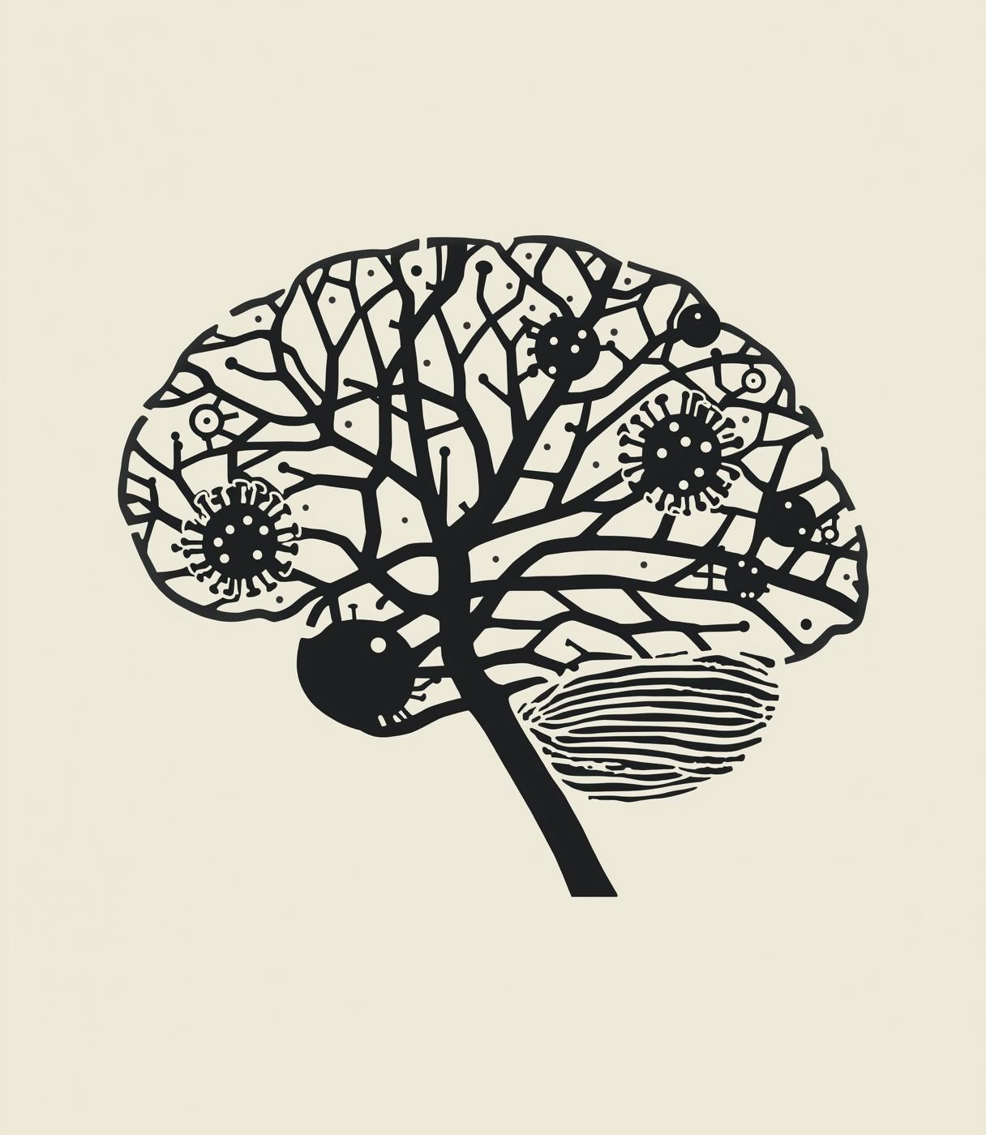




Unraveling the Transcriptomic Overlap Between SARS-CoV-2 and Neurodegeneration
A Multi-Omics Analysis (Python & R).
PRESENTED BY
Student Name: Sara Sayed Elganzory | ID: 221000509
Supervised by: Dr. Mohamed Elsayeh
Date: January 2026

Slide 2

The Research Question
Question: Does COVID-19 accelerate neurodegeneration?
Hypothesis 1 (Direct): The "Prion" Hypothesis (Viral proteins trigger misfolding).
Hypothesis 2 (Indirect): Systemic Stress (Inflammation & Oxidation).
Sara Sayed Elganzory | ID: 221000509

Slide 3
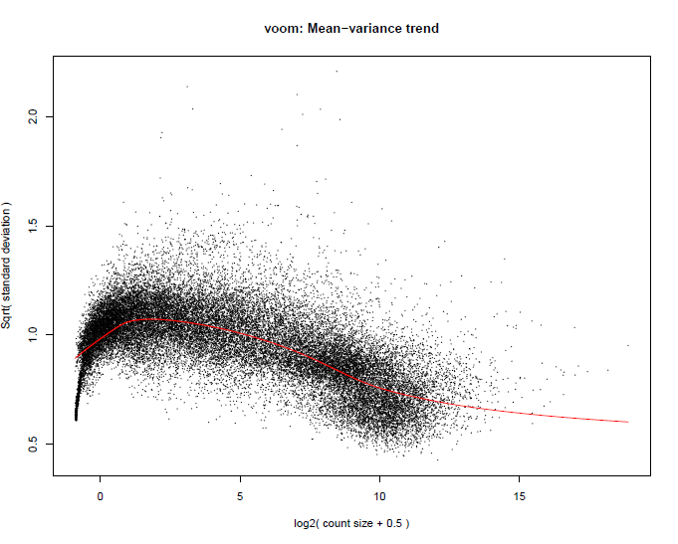
Methodology (Dual Pipeline)
Phase 1: Python (Exploratory):
Data Cleaning (Pandas)
PCA (Scikit-Learn)
Candidate Discovery
Phase 2: R (Validation):
Voom Normalization
Statistical Testing (limma/edgeR)
Pathway Enrichment (KEGG)
Sara Sayed Elganzory | ID: 221000509

Slide 4
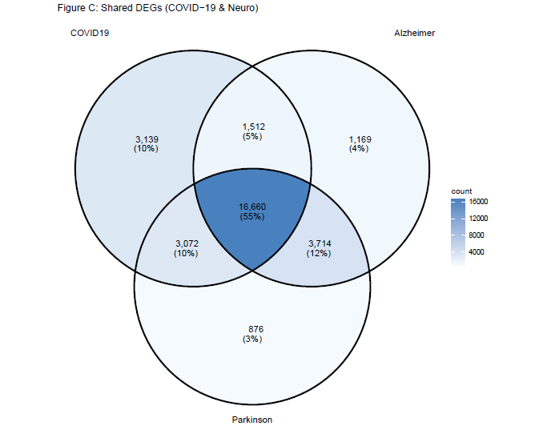
COVID-19 & Parkinson's Disease
Shared Genes: 272
Key Discovery: Upregulation of MPO (Myeloperoxidase).
Mechanism: Oxidative Stress → Dopaminergic Neuron Death.
Sara Sayed Elganzory | ID: 221000509

Slide 5
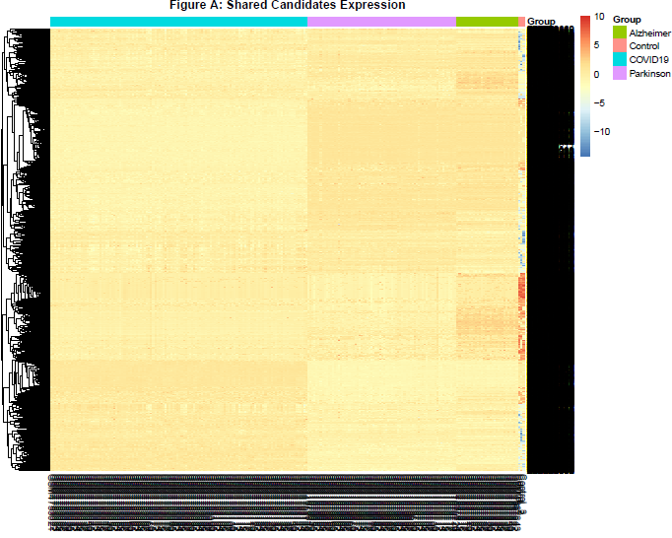
COVID-19 & Alzheimer's Disease
Shared Genes: 320
Key Discovery: Dysregulation of DOC2A (Synaptic Vesicle Fusion).
Mechanism: Synaptic Dysfunction (Link to 'Brain Fog').
Sara Sayed Elganzory | ID: 221000509

Slide 6
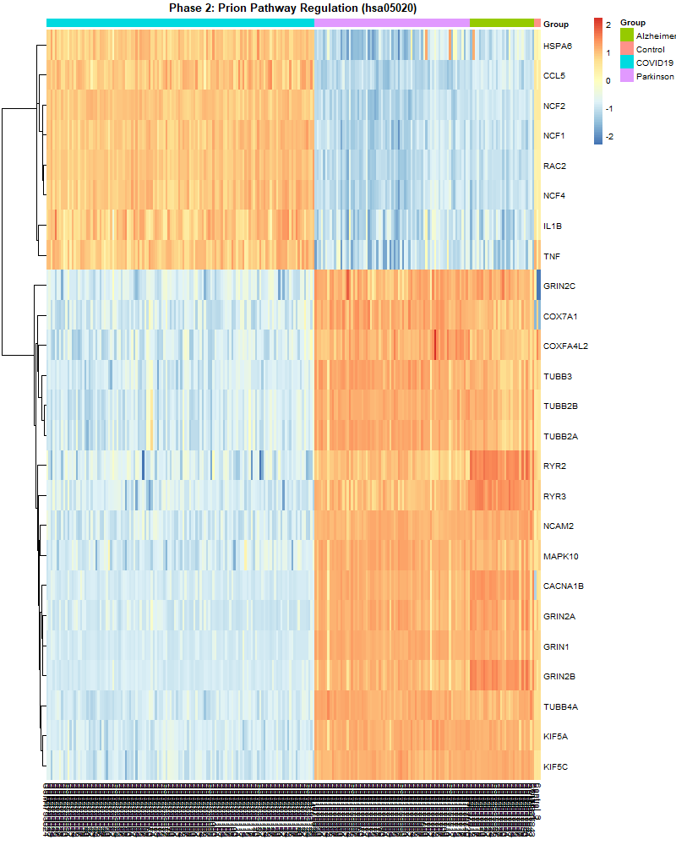
The Prion Hypothesis (Key Finding)
Direct Link: PRNP Gene = Negative (No direct overexpression).
Indirect Link: Prion Pathway (hsa05020) = Dysregulated.
Conclusion: COVID-19 induces a "Stress Environment" mimicking prion pathology.
Sara Sayed Elganzory | ID: 221000509

Slide 7
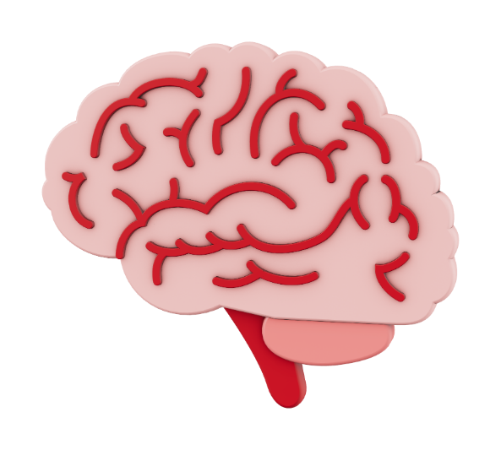
Conclusion
The "Two-Hit" Model:
Oxidative Stress (Parkinson's)
Synaptic Failure (Alzheimer's)
Environmental Mimicry (Prion Pathway)
Impact: Need for neurological monitoring & MPO inhibitors.
Sara Sayed Elganzory | ID: 221000509

Slide 8
References
Data Sources:
NCBI Gene Expression Omnibus (GEO).
Datasets: GSE157103 (COVID), GSE159699 (Alzheimer's), GSE68719 (Parkinson's).
Methodology:
Python: Pandas, SciPy, Scikit-learn (McKinney, Virtanen, Pedregosa et al.).
R/Bioconductor: limma, edgeR (Ritchie et al., Robinson et al.).
Key Literature:
Al-Aly et al. (Nature, 2021): Post-acute sequelae of COVID-19.
Yesilkaya et al. (Cureus, 2023): Spike protein and neurodegeneration.

